Slide 1
Southwestern College Leadership Presents…
2012
CROSSING BOUNDARIES

Slide 2
Respect
Opportunity
Teamwork
Acceptance
Reach out
You

Slide 3
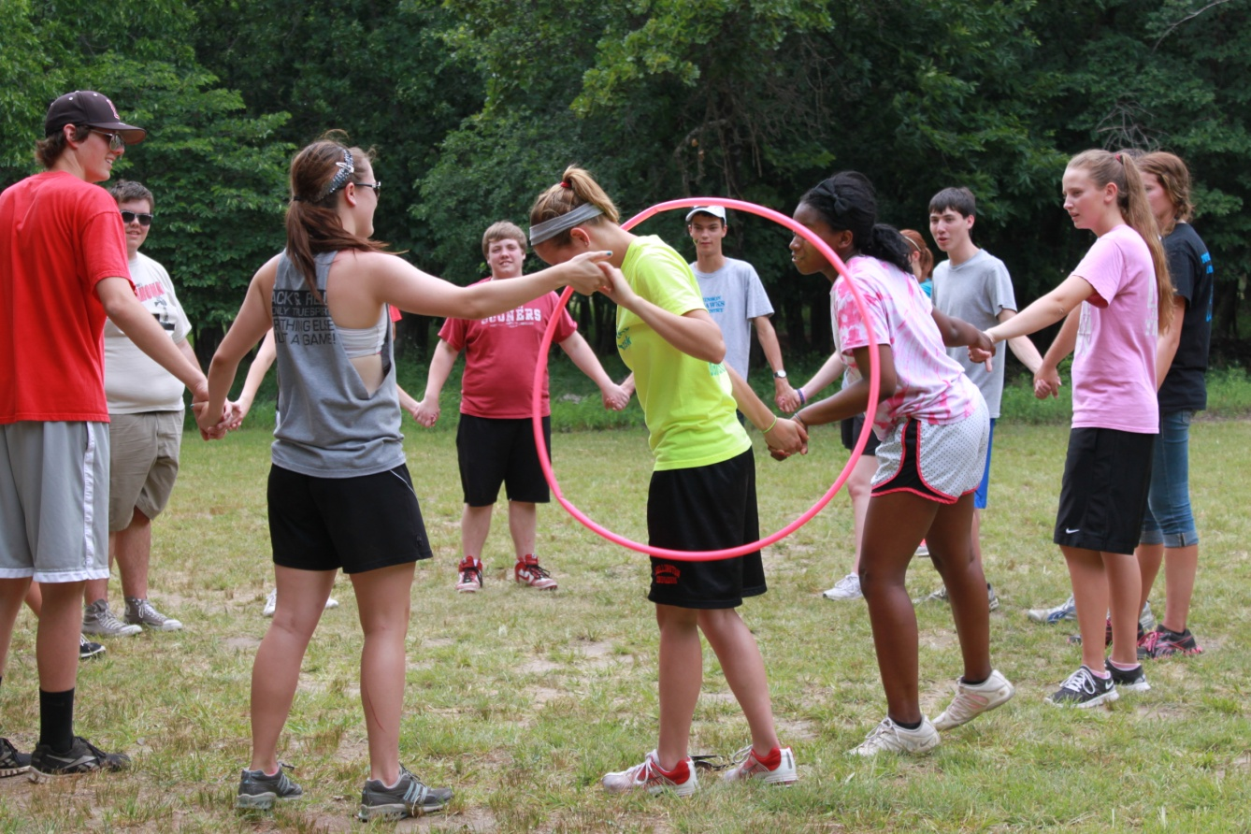
RESPECT
Getting along with others

Slide 4
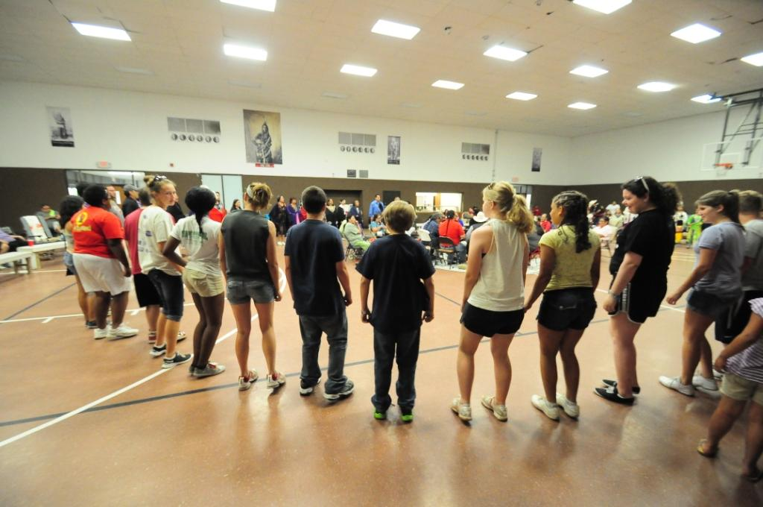
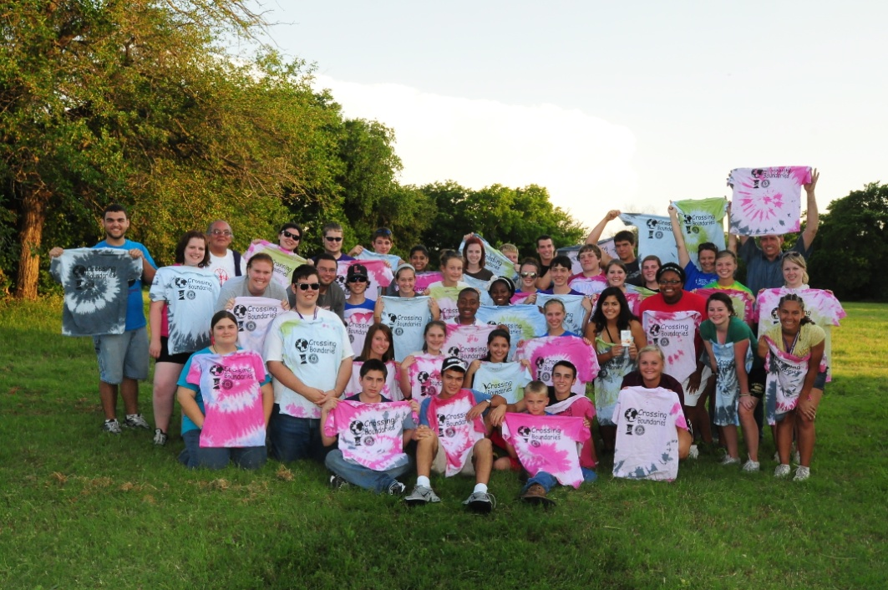
OPPORTUNITY
Rotary Camp
Contributions
Meeting New People.

Slide 5
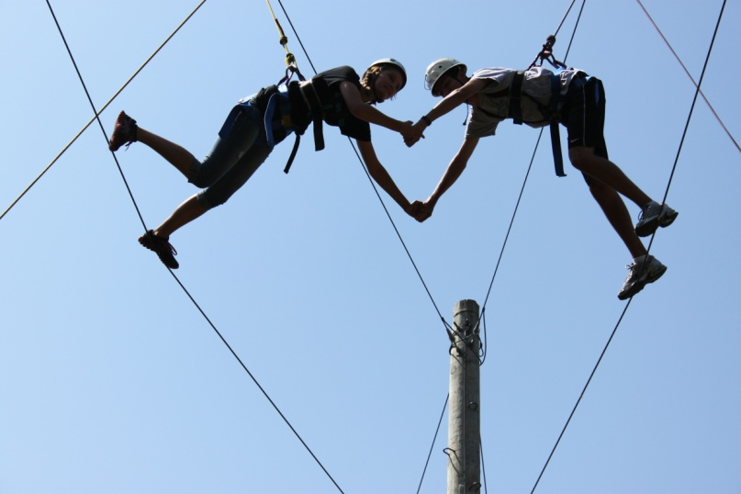
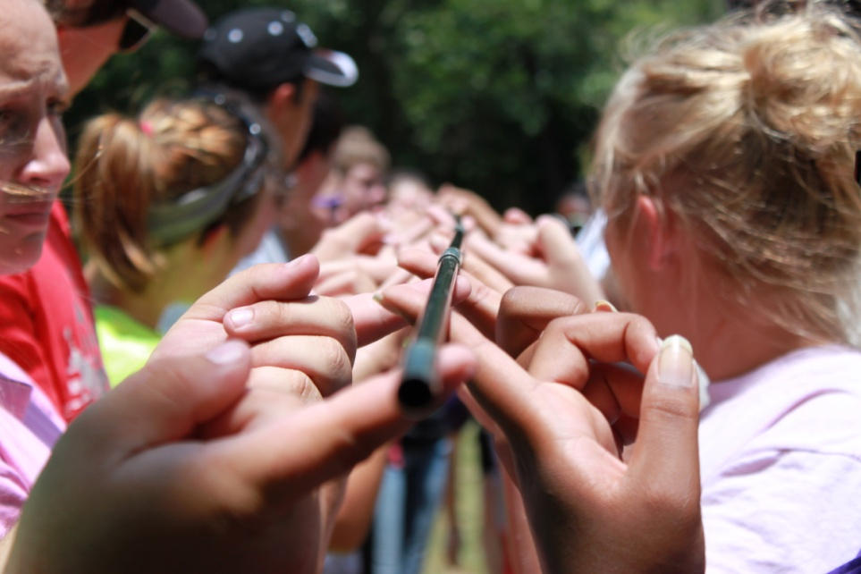
TEAMWORK
Ties
Effort
Action
Motivation
Work
Outgoing
Rotary
Kindness

Slide 6
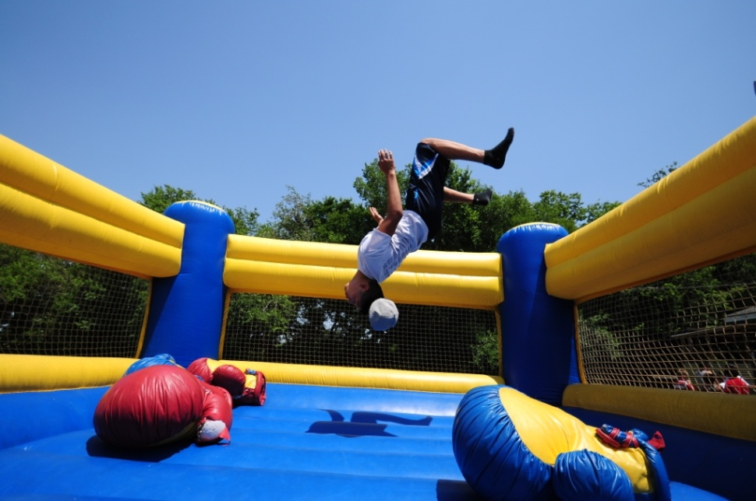
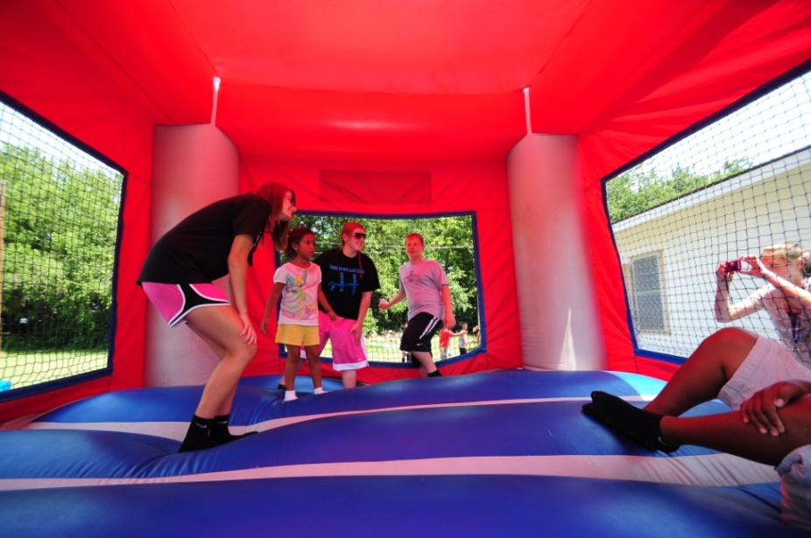
ACCEPTANCE
Not being Judged
Rotary Camp
Ponca City Indian Tribe

Slide 7
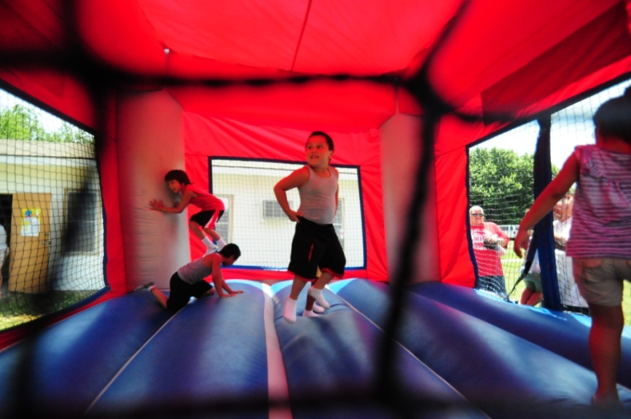
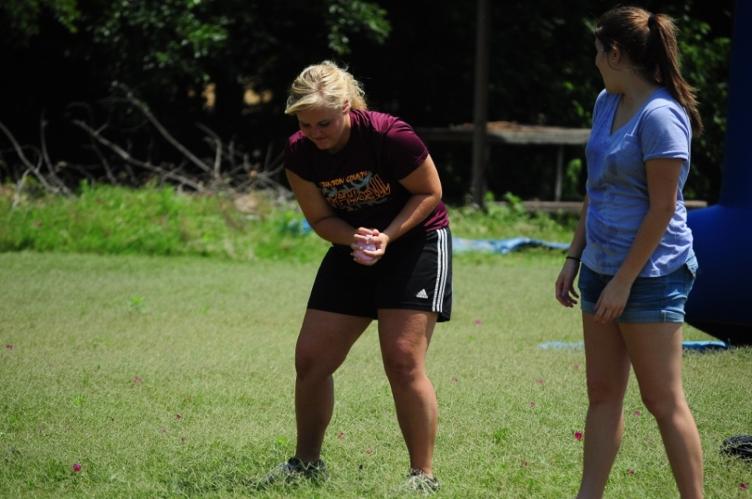
REACH OUT
Service Work
Relationships with Others
Memorial Day Flags

Slide 8
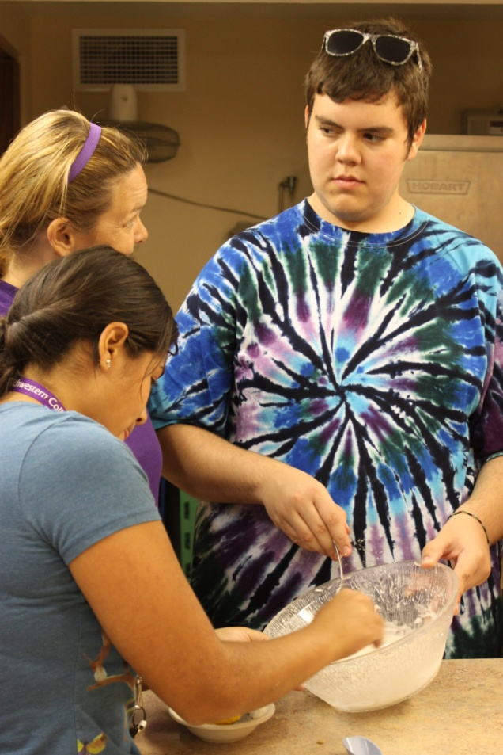
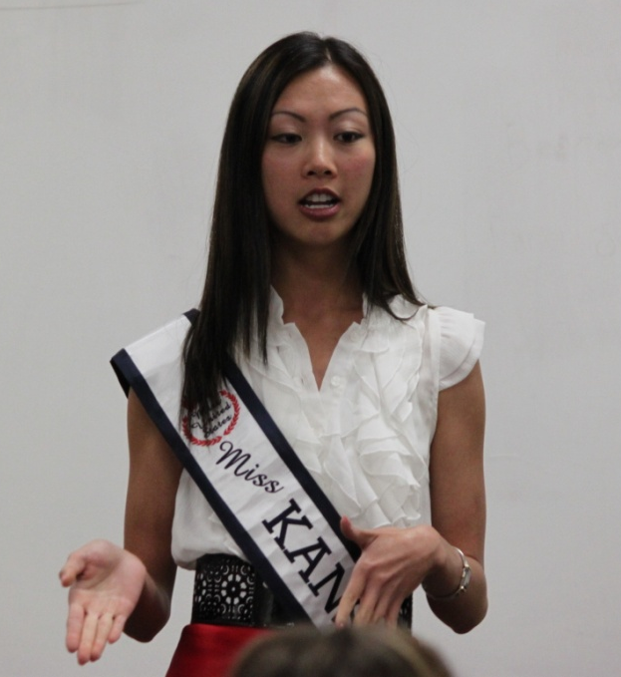
YOU
Lily Wu
Passions, Involvement, Goals, Geography, You

Slide 9
5 CHARACTERISTICS
Model the way
Clarify values by finding your voice and affirming shared ideals
Set the example by aligning actions with shared values
Inspire a shared vision
Envision the future by imaging exciting and ennobling possibilities
Enlist others in a common vision by appealing to shared aspirations
Challenge the process
Search for opportunities by seizing the initiative and by looking outward
Experiment and take risks
Enable others to act
Foster collaboration by building trust
Strengthen others by increasing self-determination and developing competence
Encourage the heart
Recognize contributions by showing appreciation for individual excellence
Celebrate the values and victories by creating a spirit of community

Slide 10
CREDO
We are here to influence the community here and bring it back to our home towns. We want to improve on skills we have already acquired and move forward in the world by improving our social skills to be the best leaders we can be. We are not only here to lead, but also to make new friendships and work together in situations out of our comfort zone.

Slide 11
